Slide 1


Slide 2
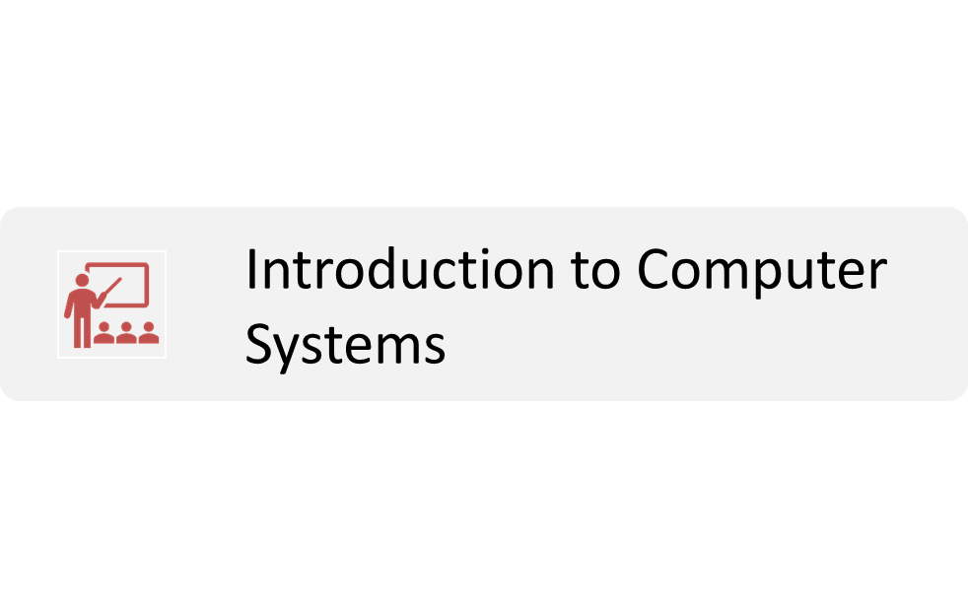
AGENDA

Slide 3
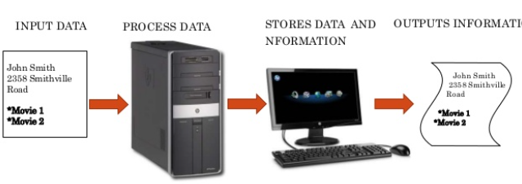
Introduction To Computer
A computer is an electronic machine that performs Input, processing, storing, and output according to programmed instructions to carry out specific tasks.

Slide 4
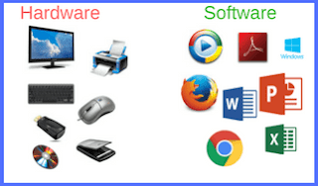
Computer Systems
The modern computer operates in a similar fashion. Input to a computer can be sent through the keyboard or mouse. The computer then processes the input, stores the result, and displays the result via the monitor, speaker, printer, or other output devices.
In general, a computer system can be decomposed into the hardware system, the software system, and the network system.
Components of a computer system:
1. Hardware
2. Software

Slide 5
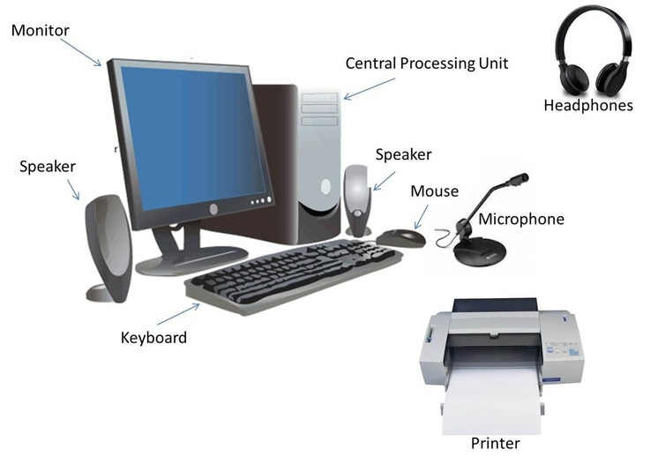
1. Hardware
The hardware system consists of external and internal physical components that enable a computer to accept input, process the input, store data, and produce outputs.

Slide 6
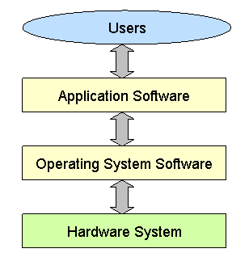
2. Software
Software System consists Operating System Software and Application Software.
The operating system software serves as the interface between application software and the hardware components.
The application software interfaces with the users of the computer system.

Slide 7
Approaches For Problem Solving
Algorithm
Approaches For Problem Solving
Pseudocodes
Flowchart
Program Development Steps

Slide 8
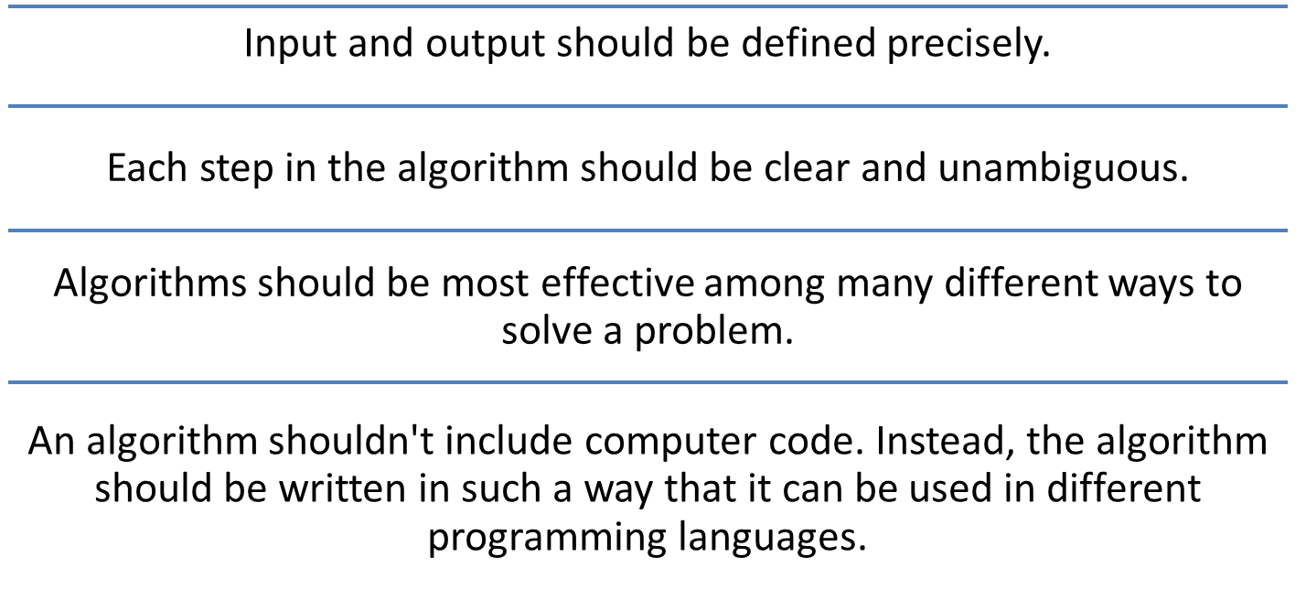
Algorithm
An algorithm is a set of well-defined instructions in sequence to solve a problem.
Qualities of a good algorithm:

Slide 9
Pseudocodes
Pseudo code is an outline of a program written in a way that it can be easily converted into a computer programming language.
Pseudo code can be broken down into five components.
        Variables
        Assignment
        Input/output
        Selection
        Repetition
Example:
Integer x,y,z,n
Set y=2,z=2
Read n
For(each x from 1 to n-1)
Print z
y=y+2
z=z+y;
End for

Slide 10
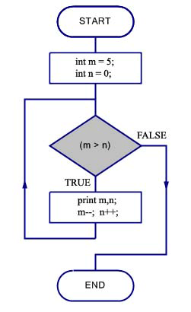
Flowchart
A flowchart is a type of diagram that represents a workflow or process. A flowchart can also be defined as a diagrammatic representation of an algorithm, a step-by-step approach to solving a task.
The flowchart shows the steps as boxes of various kinds, and their order by connecting the boxes with arrows.
This diagrammatic representation illustrates a solution model to a given problem.

Slide 11
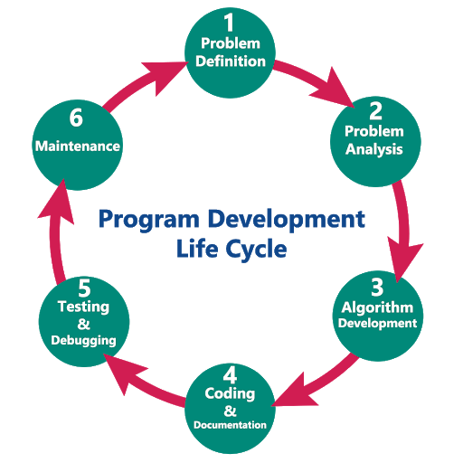
Program Development Steps
When we want to develop a program using any programming language, we follow a sequence of steps. These steps are called phases in program development.
Program Development Steps:
Problem Definition
Problem Analysis
Algorithm Development
Coding & Documentation
Testing & Debugging
Maintenance

Slide 12
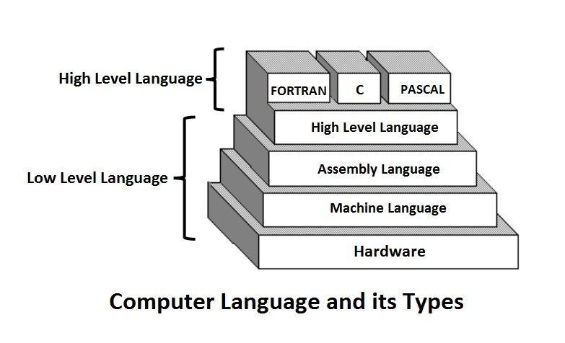
Computer Languages
Machine Language: A Binary Language composed of 0s and 1s – that is specific to each computer.
Assembly Language: Binary instructions are given abbreviated names called mnemonics which form the Assembly Language. Assembly Language is specific to a given machine.
High Level Language: Programming language intended to be machine-independent is called High level language. Instructions are called as statements.
Ex: FORTRON, PASCAL, C etc.

Slide 13
Assemblers and Compilers
Assembler is a program that translates the mnemonics into the corresponding binary machine codes of the microprocessor.
Ex: KEIL’s a51
Compiler is a program that translates the source code (statements) into the machine language (object code) compatible with the microprocessor used in the system.
Ex: TURBO C,
  BORLAND C
  GCC ..etc.
Interpreter reads the source code line by line, translates each line to machine code, and executes it before moving on to the next line
Ex: Python

Slide 14
Creating and Running C Program
Generally, the programs created using programming languages like C, C++, Java, etc., are written using a high-level language like English. But, the computer cannot understand the high-level language. It can understand only low-level language.
So, the program written in the high-level language needs to be converted into the low-level language to make it understandable for the computer.
This conversion is performed using either Interpreter or Compiler.
A compiler is a program that converts high-level language instructions into low-level language instructions.
Generally, the compiler performs two things, first it verifies the program errors, if errors are found, it returns a list of errors otherwise it converts the complete code into the low-level language.

Slide 15
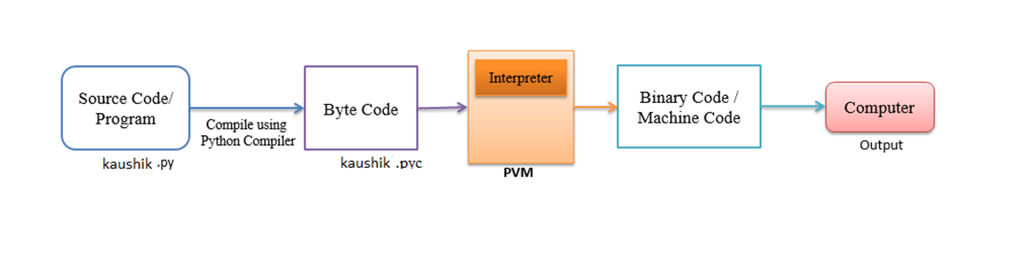
Creating and Running Python Program
We use the following steps to create and execute Python programs in Windows OS:
Step 1: Creating a Source Code
Step 2: Compile Source Code
Step 3: Executing / Running Executable File
Step 4: Check Result
Execution Process of a Python Program:

Slide 16
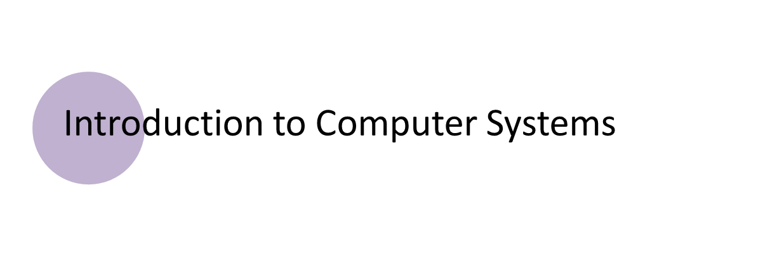
SUMMARY

Slide 17

ANY QUERIES?

Slide 18

PRACTICE CODING

Slide 19

YOUR FEEDBACK IS IMPORTANT FOR US
Notes:
Please encourage students to ask doubts in Telegram groups or through private whats app chat.

Slide 20
THANK YOU

